Slide 1

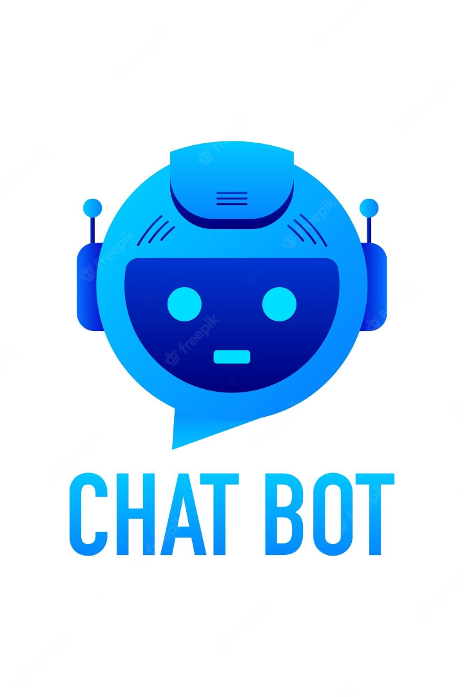

Creating Chat AI
Chat AI is revolutionizing the way we interact with technology. In this presentation, we'll explore the different types of chatbots, the benefits of implementing them, and how to build one.
by Harsha Lakkireddy

Slide 2
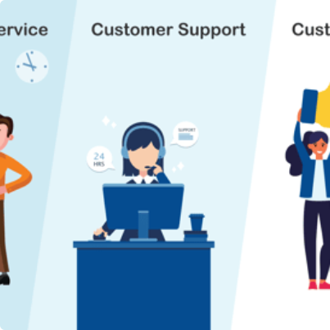

The Power of Chat AI
Conversational Customer Support
Virtual Personal Assistant
Streamlined Business Efficiency
A chatbot that can perform a variety of tasks and is always ready to assist you on the go.
Automate repetitive tasks and information retrieval to reduce workload and increase productivity.
Increase customer satisfaction and retention with a chatbot that responds instantly to their inquiries 24/7.

Slide 3

Key Components of Chatbot Building
1
NLP
2
Dialog Management
Natural Language Processing is essential for understanding and interpreting user inputs.
Effective dialog management boosts user engagement and satisfaction by understanding user context.
3
Integration
4
Testing and Debugging
The chatbot must be integrated with various systems and APIs to provide relevant and useful information to the user.
Thorough testing and debugging are crucial to deliver a fully functional and reliable chatbot.

Slide 4
Designing a Chatbot
User-Centered
Useful and Engaging
Simple and Intuitive
The user should always be our primary focus. Design with their needs, expectations, and context in mind.
The chatbot should provide relevant and concise information in an engaging and friendly manner.
Design a chatbot that is easy to use with clear and concise instructions, and avoid overcomplicating the interface.
Feedback and Personalization
Give feedback to the user and allow for personalization options to enhance user experience and build trust.

Slide 5
Types of Chatbots
AI-Powered Chatbots
Use machine learning algorithms and natural language processing (NLP) to understand user inputs and provide more personalized responses.
1
2
3
Rule-Based Chatbots
Hybrid Chatbots
Use predefined rules and scripts to respond to user inputs and follow a predetermined logic path.
Use a combination of predefined rules and AI algorithms to provide efficient and reliable conversational experiences.

Slide 6
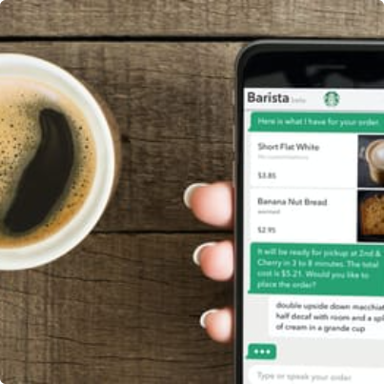
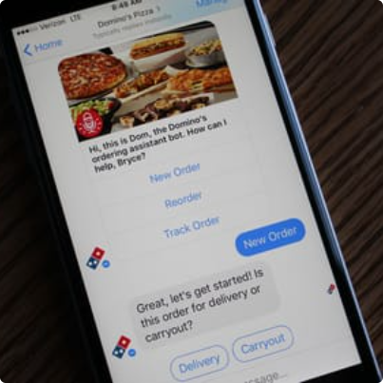
Successful Chat AI Implementations
Starbucks Chatbot
Domino's Chatbot
Sephora Chatbot
Allows customers to order and pay for their drinks using text or voice commands on their mobile devices.
Allows customers to order and track their pizzas through their Facebook Messenger app, offering personalized recommendations and discounts.
Helps customers learn about products, find stores nearby, and schedule appointments with experts in real-time.

Slide 7

The Future of Chat AI
With the advancements in machine learning, natural language processing, and AI technologies, chat AI will become an even more integral part of our daily lives. Chatbots will become more intelligent and conversational, and we'll see them integrated into virtual reality environments, voice assistants, and smart home devices.

